Slide 1
FraudLens
SQL PROJECT · MYSQL
Financial Transaction Risk Analysis
Database design, rule-based fraud alerts and SQL analysis

Slide 2
Project Overview
Goal
Approach
Output
Detect and review risky financial transactions using clear, rule-based alerts.
A relational MySQL database, fraudlens_db, with 6 linked tables.
Fraud alerts ranked by risk level, ready for analyst review.
FraudLens · 2/10

Slide 3
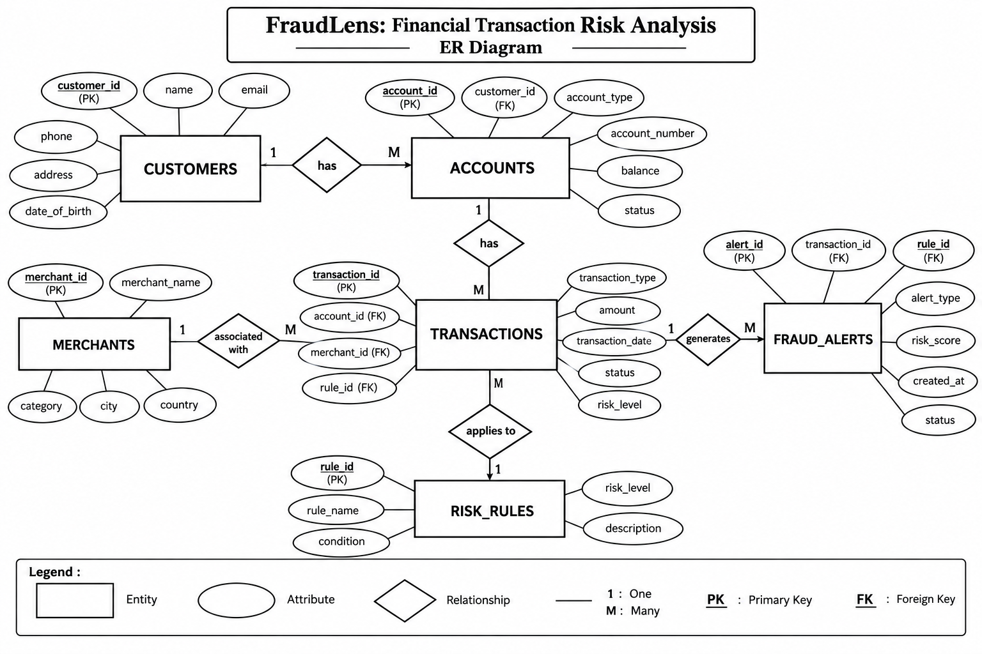
ER Diagram
FraudLens · 3/10

Slide 4
Database Schema
Customers
Accounts
Merchants
customer_id, name, email, phone, city, registration_date
account_id, customer_id (FK), account_number, type, balance, status
merchant_id, name, category, city, status
Transactions
Risk_Rules
Fraud_Alerts
transaction_id, account_id (FK), merchant_id (FK), date, type, amount, payment_method, status, location_city, device_id
rule_id, rule_name, description, threshold_amount, risk_level, is_active
alert_id, transaction_id (FK), rule_id (FK), alert_date, risk_level, alert_status, notes
FraudLens · 4/10

Slide 5
Data Integrity
Keys and uniqueness
Foreign keys
Auto-increment primary keys. Unique email, phone, account_number and rule_name.
Accounts to Customers. Transactions to Accounts and Merchants. Alerts to Transactions and Risk_Rules.
CHECK constraints
Defaults
balance of 0 or more, amount above 0, and fixed lists for types, statuses and risk levels.
Balance 0.00, account Active, transaction Completed, alert Open.
FraudLens · 5/10

Slide 6
Risk Rules
Rule | Trigger | Level
High Value Transaction | Amount above 50,000 | High
Unusual Purchase | Purchase above 20,000 | Medium
Blocked Merchant | Linked to a blocked merchant | Critical
Frozen Account Activity | Frozen account involved | Critical
Failed Transaction Review | Transaction failed | Medium
FraudLens · 6/10

Slide 7
Sample Data
8
8
6
20
9
Customers
Accounts
Merchants
Transactions
Fraud alerts
Alerts are rule-based samples, not confirmed fraud.
FraudLens · 7/10

Slide 8
Core SQL Techniques
Filtering
Aggregates and grouping
Joins
WHERE, BETWEEN, IN, LIKE, IS NULL, ORDER BY and LIMIT.
COUNT, SUM, AVG, MIN, MAX with GROUP BY and HAVING.
INNER, LEFT, RIGHT, CROSS, and a full outer join built with UNION.
Subqueries and sets
CASE logic
String and date functions
Above-average amounts, customers with 50,000+ transactions, UNION and UNION ALL.
Amount-based risk labels: High, Medium, Low.
UPPER, CONCAT, DATE, HOUR, DATEDIFF.
FraudLens · 8/10

Slide 9
Advanced SQL
CTE
Window functions
View
Customer totals: transaction count and amount.
DENSE_RANK by amount and a running total per account.
transaction_risk_report joins customers, accounts, merchants.
Indexes
Transactions
Date, amount, and account plus date.
START TRANSACTION and ROLLBACK demo on alert status.
FraudLens · 9/10

Slide 10
Fraud Alert Analysis
3
4
2
9
Critical alerts
High alerts
Medium alerts
Open or investigating
Rules for blocked merchants, frozen accounts and high-value transfers turn raw transactions into a ranked review queue. Alerts flag candidates for analysts; they do not confirm fraud.
FraudLens · 10/10

